Slide 1

CSE 423
Virtualization and Cloud Computing
Lecture 11
Module III
Dr. Madhavi Dhingra

Slide 2
Contents
Workload distribution architecture,
Cloud bursting architecture,
Disk provisioning architecture,
Dynamic failure detection and recovery architecture,
Cloud Computing Architecture,

Slide 3
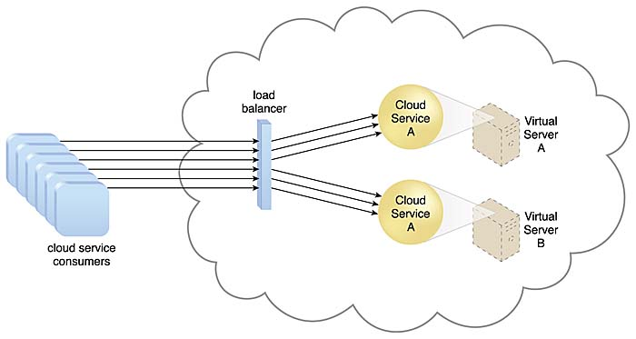
1. Workload Distribution Architecture
Workload distribution architecture uses IT resources that can be horizontally scaled with the use of one or more identical IT resources. This is accomplished through the use of a load balancer that provides runtime logic which distributes the workload among the available IT assets evenly. This model can be applied to any IT resource and is commonly used with; distributed virtual servers, cloud storage devices, and cloud services.

Slide 4
Workload Distribution Architecture
In addition to a load balancer and the previously mentioned resources, the following mechanisms can also be a part of this model:
Audit Monitor – When distributing runtime workloads, the type and geographical location of the IT resources that process the data can determine whether monitoring is necessary to fulfill legal and regulatory requirements.
Cloud Usage Monitor – Various monitors can be involved to carry out runtime workload tracking and data processing.
Hypervisor – Workloads between hypervisors and the virtual servers that they host may require distribution.
Logical Network Perimeter – The logical network perimeter isolates cloud consumer network boundaries in relation to how and where workloads are distributed.
Resource Cluster – Clustered IT resources in active mode are commonly used to support workload balancing between different cluster nodes.
Resource Replication – This mechanism can generate new instances of virtualized IT resources in response to runtime workload distribution demands.

Slide 5
Workload Distribution Architecture
The workload architecture model basically functions as follows; Resource A and resource B are exact copies of the same resource. Inbound requests from consumers are handled by the load balancer which forwards the request to the appropriate resource dependent on workload being handled by each resource. In other words, if resource A is busier than resource B, it will forward the resource request to resource B. In this manner this model distributes the load among the available IT resources based on workload of each resource.
The following example on how this could be applied in a business environment is based on information provided by Cloud Patterns web.
A system contains two (2) virtual instances of a cloud-based domain controller on two (2) different physical servers. To increase performance, domain queries would be received by a load balancer which would then forward the query to the appropriate instance of the domain controller based on the current workload of each instance. In this manner the workload is evenly distributed between both of the servers and domain controller instances.

Slide 6
2. Cloud Bursting Architecture
Cloud bursting is a configuration method that uses cloud computing resources whenever on-premises infrastructure reaches peak capacity. When organizations run out of computing resources in their internal data center, they burst the extra workload to external third-party cloud services. Cloud bursting is a convenient and cost-effective way to to support workloads with varying demand patterns and seasonal spikes in demand.
To make it simple to understand, when the private cloud reaches its resource capacity limit, then in order to maintain uninterrupted services for the users, the private cloud redirects the overflow traffic to the public cloud. Thus, as per this configuration, the private cloud “bursts” into the public cloud when triggered with the high demand usage or a user makes a manual request.
The cloud bursting architecture establishes a form of dynamic scaling that scales or “bursts out” on-premise IT resources into a cloud whenever predefined capacity thresholds have been reached. The corresponding cloud-based IT resources are redundantly pre-deployed but remain inactive until cloud bursting occurs. After they are no longer required, the cloud-based IT resources are released and the architecture “bursts in” back to the on-premise environment.

Slide 7
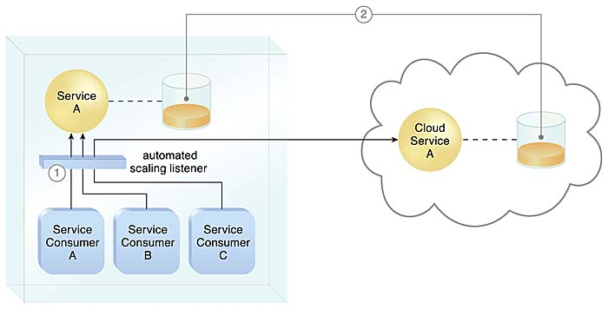
2. Cloud Bursting Architecture
Cloud bursting is a flexible scaling architecture that provides cloud consumers with the option of using cloud-based IT resources only to meet higher usage demands. The foundation of this architectural model is based on the automated scaling listener and resource replication mechanisms.
The automated scaling listener determines when to redirect requests to cloud-based IT resources, and resource replication is used to maintain synchronicity between on-premise and cloud-based IT resources in relation to state information

Slide 8
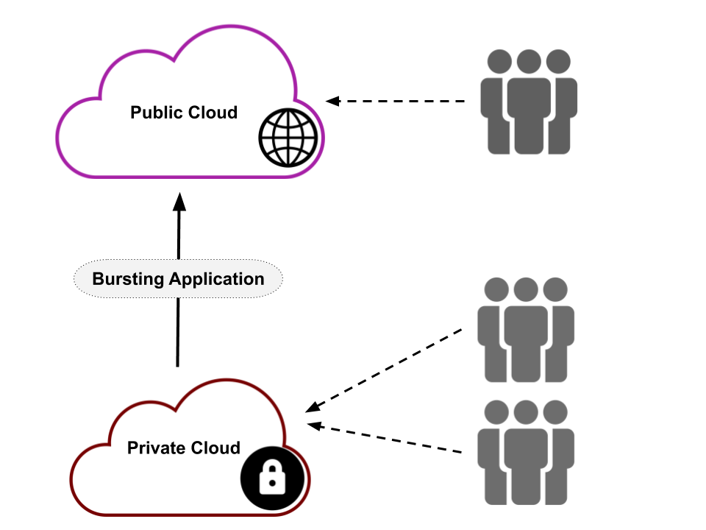
Cloud Bursting Architecture

Slide 9
Why is cloud bursting important?
Many organizations want to continue using their existing on-premises computing infrastructure and also get the benefits of the public cloud. They can deploy a cloud-bursting hybrid cloud architecture to access public cloud resources when they have no more on-premises compute capacity. By implementing cloud-bursting techniques, cloud consumers can do the following:
Use local resources efficiently
Reduce further investment in on-premises infrastructure costs
Enjoy the scale and flexibility that public clouds bring
Avoid service interruption to business-critical applications due to sudden workload spikes

Slide 10
When do organizations use cloud bursting?
The following are common examples of cloud-bursting use cases:
Marketing campaigns
Like product launches or seasonal sales, marketing campaigns generate a huge traffic influx that subsides after the event ends. Although your on-premises resource capacity might be adequate at other times, it might not be able to manage the overflow traffic. You can use cloud bursting to meet peak demands at these times without having to purchase extra computing resources.
Big data analytics
Big data modeling tasks, such as 3-D rendering or machine learning, often require more resources, like processor capacity and internal memory. Because these tasks are not the norm, they are suited for cloud bursts to the public cloud. Public cloud providers also have specially optimized resources for big data analytics and artificial intelligence tasks.

Slide 11
Types of cloud bursting
Manual bursting
Manual bursting is a cloud-bursting method that you can use to manually provision and de-provision public cloud services as needed. Load balancing software monitors resource use and sends alerts that you can act on manually.
Pros and cons
Organizations use manual bursting to create large but temporary cloud deployments for specific tasks. Manual bursting helps test new cloud-bursting projects. However, it increases the risk of human error and deployment oversights.
Automated bursting
Automated bursting uses cloud-bursting tools to automatically provision resources from your public cloud provider. You can set up policies that define how the tool handles greater demand. The tool dynamically provisions cloud resources when they are required and de-provisions them when demand falls.
Pros and cons
Automated cloud-bursting tools can automatically create, grow, shrink, and remove cloud resources. They reduce the risk of human error and efficiently use both your public and on-premises infrastructure.

Slide 12
When do organizations use cloud bursting?
Distributed load balancing
Distributed load balancing is a cloud-bursting approach that operates workloads simultaneously between the public cloud infrastructure and your data center. You have to set up a standby deployment in the public cloud with some minimum capacity. You also have to set load thresholds in your on-premises infrastructure and distribute them as needed. Load balancing operations share traffic between your on-premises infrastructure and public cloud, automatically scaling up the standby deployment to deal with greater loads.

Slide 13
Real-life Example
To make things work in NASA requires proper management of time and money. NASA had to spend $200,000 for new datacentre hardware and subsequently wait for approx. 100 days to process petabytes of data from the Orbiting Carbon Observatory 2 (OCO 2)
Instead of waiting for the right time, NASA switched to the Amazon Web Services (AWS) cloud. This approach helped the engineers to achieve better insights for $7,000 in a minimum of six days. Hence, the ‘cloud bursting’ technique has proven itself to be one of the most effective and affordable solutions in the scientific community. Also, the way it has helped manage processing high volume data spikes is remarkable.

Slide 14
More like this…
Your organization wishes to launch a new product in the market. As a result, you will be looking forward to running marketing campaigns that will further help generate huge traffic to your website. Thus, leading to the requirement of an extended cloud resource. Now, imagine the same situation on a larger scale. Imagine how it would be when organizations are running marketing campaigns for a Hollywood Movie Promotion or a video game release. For a short period, but these events are huge and create a stampede of traffic. In such cases, using the cloud bursting technique is highly beneficial.
Many businesses work on a seasonal basis. These businesses once in a year or as per the seasonal demand account for huge traffic coming to their website, such as in the case of: The Ending Seasonal Sale or Holiday rush shopping on some of the best eCommerce platform or shopping websites, End of business quarter, During the Campaign Fundraising for political elections, Education Opportunities proposal suggested by candidates during the election period. As a result, with the cloud bursting technique, you will be always prepared in advance for the high seasonal traffic. This, in turn, will never let your organization face any interruptions when the applications are running.
Imagine your bank is spending a huge amount of around 1 million on essential additional hardware and software to risk report the Hadoop cluster. Now! Instead of spending such a large amount on extra software and hardware, try switching to the cloud bursting technique. Run a subset of your data using the cloud bursting on Amazon Web Services (AWS) for $2.20 and other cloud service providers like Google for .50 cents. This way, your bank will be able to save large data at a very low price and face minimal upfront investment. Also, the cloud bursting technique is best suitable for software development and analytics.
Flexible Scaling, Improved Business Continuity and Low cost operations

Slide 15
3. Disk Provisioning Architecture
Elastic Disk Provisioning - How can the billing of cloud storage be based on actual, fluctuating storage consumption?
Problem
When cloud providers charge for fixed-disk storage allocation, the billing is based on the capacity of the disks, not their actual usage. As a result, cloud consumers are generally billed for more storage than they consume.
Solution
A dynamic storage provisioning system is established to dynamically allocate and remove (and collect billing data for) storage space at a granular level.
Application
Thin provisioning and dynamic allocation technology is used with cloud storage monitors to enable elastic storage space provisioning and the measuring of usage data for billing purposes.

Slide 16
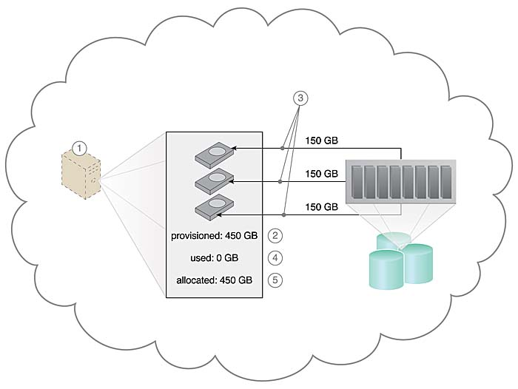
Disk Provisioning Architecture
The elastic disk provisioning architecture establishes a dynamic storage provisioning system that ensures that the cloud consumer is granularly billed for the exact amount of storage that it actually uses.

Slide 17
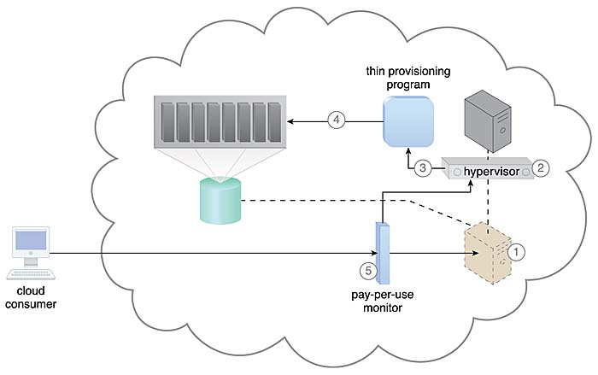
Disk Provisioning Architecture
Thin-provisioning software is installed on virtual servers that process dynamic storage allocation via the hypervisor, while the pay-per-use monitor tracks and reports granular billing-related disk usage data.

Slide 18
Contd…
A request is received from a cloud consumer, and the provisioning of a new virtual server instance begins
As part of the provisioning process, the hard disks are chosen as dynamic or thin-provisioned disks
The hypervisor calls a dynamic disk allocation component to create thin disks for the virtual server
Virtual server disks are created via the thin-provisioning program and saved in a folder of near-zero size. The size of this folder and its files grow as operating applications are installed and additional files are copied onto the virtual server
The pay-per-use monitor tracks the actual dynamically allocated storage for billing purposes.\
The following mechanisms can be included in this architecture in addition to the cloud storage device, virtual server, hypervisor, and pay-per-use monitor:
Cloud Usage Monitor – Specialized cloud usage monitors can be used to track and log storage usage fluctuations.
Resource Replication – Resource replication is part of an elastic disk provisioning system when conversion of dynamic thin-disk storage into static thick-disk storage is required.

Slide 19
4. Dynamic failure detection and recovery architecture
Problem
Cloud environments can be comprised of vast quantities of IT resources being accessed by numerous cloud consumers. Any of those IT resources can experience predictable failure conditions that require intervention to resolve. Manually administering and solving standard IT resource failures in cloud environments is generally inefficient and impractical.
Solution
A resilient watchdog system is established to monitor and respond to a wide range of pre-defined failure scenarios. This system is further able to notify and escalate certain failure conditions that it cannot automatically solve itself.
Application
The resilient watchdog system relies on a specialized cloud usage monitor (that can be referred to as the intelligent watchdog monitor) to actively monitor IT resources and take pre-defined actions in response to pre-defined events.

Slide 20
Dynamic failure detection and recovery architecture
The resilient watchdog system, together with the intelligent watchdog monitor, performs the following five core functions: Watching, deciding upon an event, acting upon an event, reporting, Escalating. The following mechanisms are required:
Audit Monitor – This mechanism may be required to ensure that the manner in which this pattern is carried out at runtime is in compliance with any related legal or policy requirements.
Cloud Usage Monitor – Various specialized cloud usage monitors may be involved with monitoring and collecting IT resource usage data as part of failure conditions and recovery, notification, and escalation activity.
Failover System – Failover is fundamental to the application of this pattern, as the failover system mechanism is generally utilized during the initial attempts to recover failed IT resources.
SLA Management System and SLA Monitor – The functionality introduced by the application of the Dynamic Failure Detection and Recovery pattern is closely associated with SLA guarantees and therefore commonly relies on the information managed and processed by these mechanisms.

Slide 21
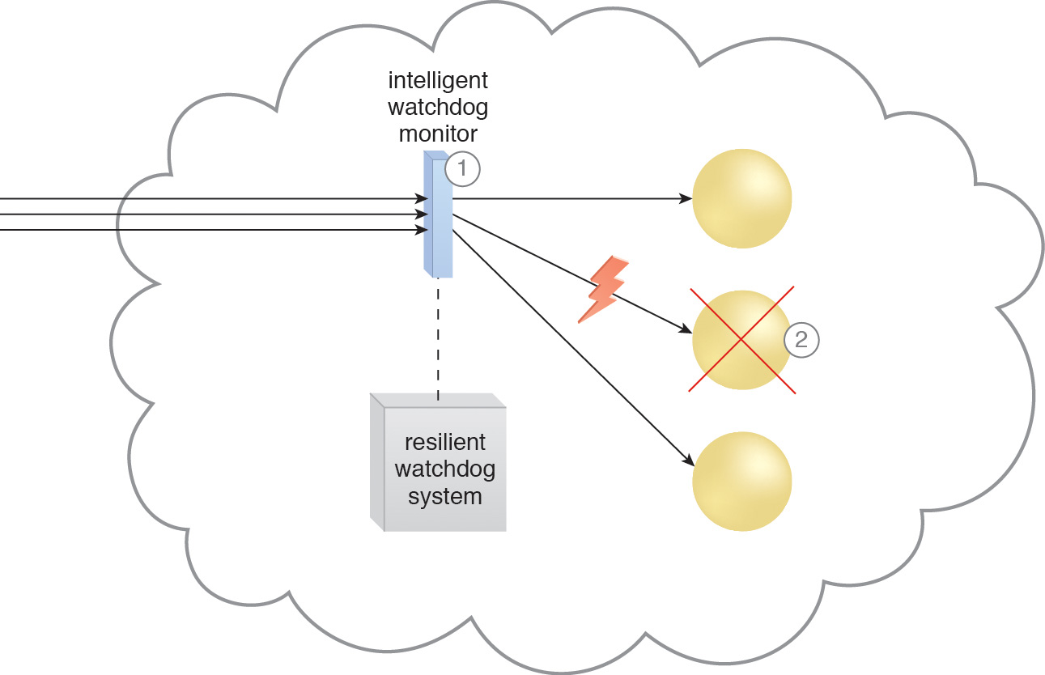
Dynamic failure detection and recovery architecture
The intelligent watchdog monitor keeps track of cloud consumer requests (1) and detects that a cloud service has failed (2)

Slide 22
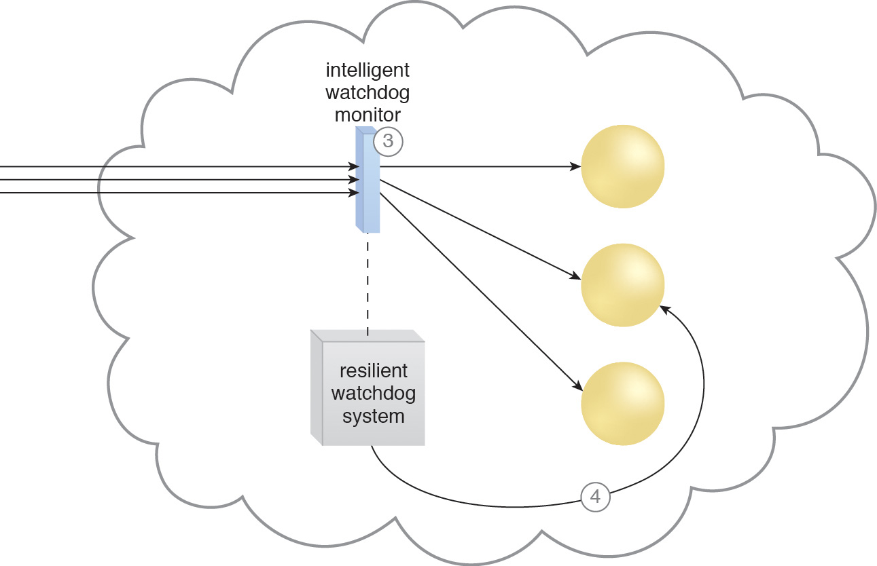
Dynamic failure detection and recovery architecture
The intelligent watchdog monitor notifies the watchdog system (3), which restores the cloud service based on predefined policies (4).

Slide 23
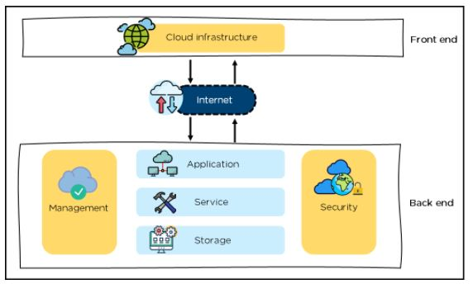
5. Cloud Computing Architecture
Cloud Computing Architecture is divided into two parts, i.e., front-end and back-end. Front-end and back-end communicate via a network or internet.

Slide 24
Cloud Computing Architecture
Front End
It provides applications and the interfaces that are required for the cloud-based service.
It consists of client’s side applications, which are web browsers such as Google Chrome and Internet Explorer.
Cloud infrastructure is the only component of the front-end.
Cloud infrastructure consists of hardware and software components such as data storage, server, virtualization software, etc.
It also provides a Graphical User Interface to the end-users to perform respective tasks.

Slide 25
Cloud Computing Architecture
Back End
It is responsible for monitoring all the programs that run the application on the front-end
It has a large number of data storage systems and servers.
The components of the back-end cloud architecture are mentioned below. Let's understand them in detail one by one.
Application
It can either be a software or a platform
Depending upon the client requirement, the application provides the result to the end-user (with resources) in the back end
Service
Service is an essential component in cloud architecture
Its responsibility is to provide utility in the architecture
In a Cloud, few widely used services among the end-users are storage application development environments and web services
Looking forward to enhancing your cloud computing skills? Enroll in our Caltech cloud computing certification today and take your career to new heights.
Storage
It stores and maintains data like files, videos, documents, etc. over the internet
Some of the popular examples of storage services are below:
Amazon S3
Oracle Cloud-Storage
Microsoft Azure Storage
Its capacity varies depending upon the service providers available in the market

Slide 26
Cloud Computing Architecture
Management
Its task is to allot specific resources to a specific task, it simultaneously performs various functions of the cloud environment
It helps in the management of components like application, task, service, security, data storage, and cloud infrastructure
In simple terms, it establishes coordination among the cloud resources
Security
Security is an integral part of back-end cloud infrastructure
It provides secure cloud resources, systems, files, and infrastructure to end-users
Also, it implements security management to the cloud server with virtual firewalls which results in preventing data loss.

